Slide 1
MICROSOFT POWERPOINT
By CSBS Batch2

Slide 2
Transitions
We can add transitions to the slide.
The slides transition is visual effect ,that occurs when we navigate from one slide.
Users can add sound , control speed, and customize the visualization of transition effects

Slide 3
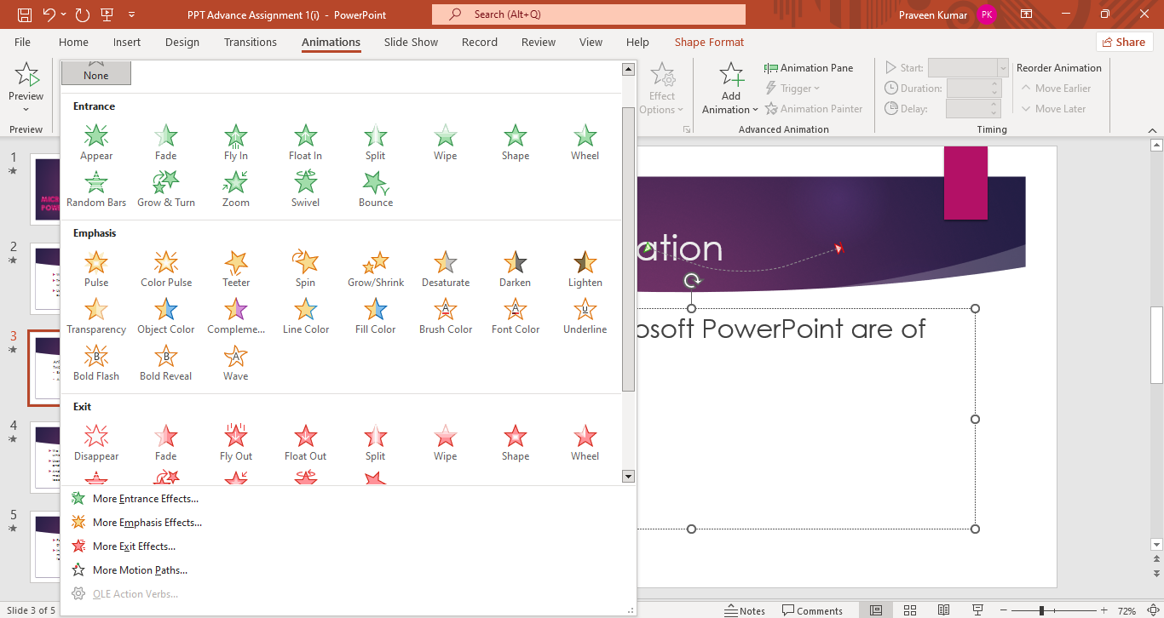
Animation
Animation Types
Basic
Advanced

Slide 4
Screen Recording
We can record our screen and related audio , which can be embed in the presentation .
Users need a microphone, speaker to record and listen to the screen recording.
And also screen recording files are heavy , make sure there is enough disk space in the local drive.

Slide 5
Exporting to PDF
PowerPoint presentations can be saved in the pdf format.
In the format other users will not be able to make any changes as the layout and the formatting freezes

Slide 6

THANK YOU

